Slide 1
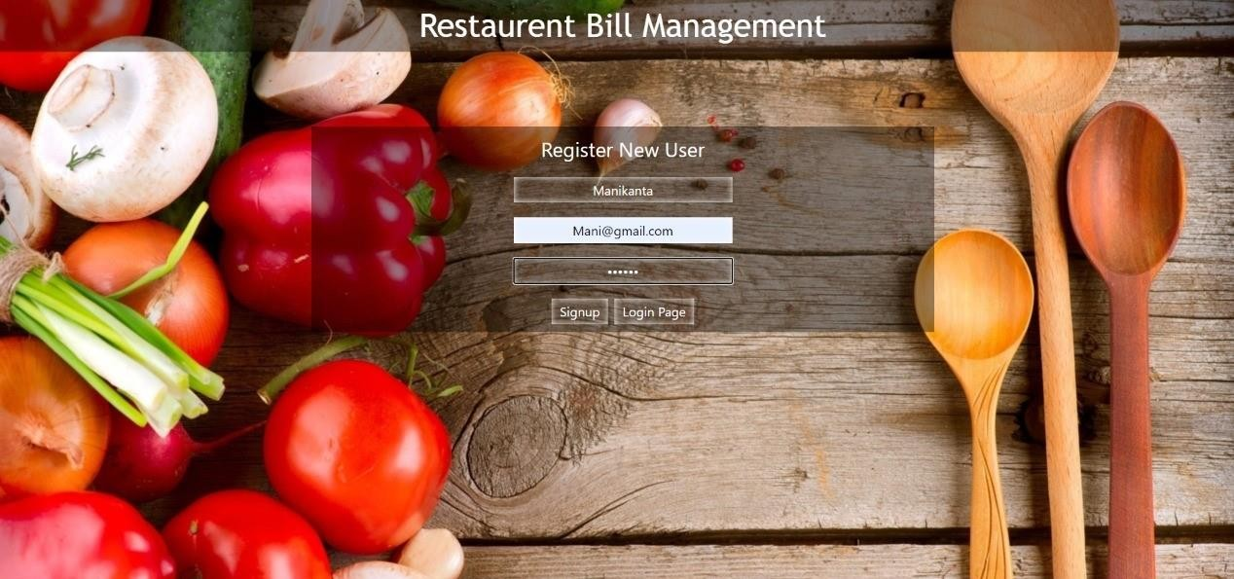
RESTAURANT MANAGEMENT SYSTEM
1. Shashank M
- AP18110010528
2. Hemanth M
- AP18110010535
3. Manikanta K
- AP18110010558
◆

Slide 2
Abstract
Due to heavy work and some other important things in our daily life people now a days are preferring restaurant food rather than cooking food at home. So we are seeing a increase in the number of hotels and there are different methods for managing restaurants, different restaurants use different managing techniques. So to make the restaurant management easy for the new restaurants and hotels we are developing a software which is easy to use and affordable to buy, this software also generates the bill automatically. Small and medium restaurants can be benefitted by switching from manual restaurant management to automated or software based restaurants which is not only for serving food but also for making better service to the customers and we can manage things very efficiently with more ease with the restaurant management system.

Slide 3
Introduction
Restaurant management system is a process of ordering food from a restaurant through a web page our aim in this project is to reduce the time and effort of the management and the customers, this service will allow customers to keep their accounts with them in order to make frequent orders convenient. This project is designed to handle all the primary information to calculate the bill and this project intends to introduce more user friendliness in various activities such as record updating, maintenance and searching the main purpose of this project is to reach wide range of customers while not interacting with management directly this system will give accurate details about customer and their food orders will help the management to identify the most favorite and least favorite food of the customers so the management can improve their taste and quality of the food they provide.

Slide 4
Website Description
In this website we want to make the interaction between customer and the management more comfortable, firstly the user should download the web application then after opening the application the user should register with their email address and they should create a password for that account, after registering to the account successfully the user may login to the account and the user can access to the menu of the restaurant and now he can select the quantity of food items, add to the cart and then edit the quantity of food in the cart after confirming if they need the food items then the user can checkout after the management can access the user’s cart by logging into the admin account and now the admin can confirm the user’s needed and generate the bill of the food items.

Slide 5
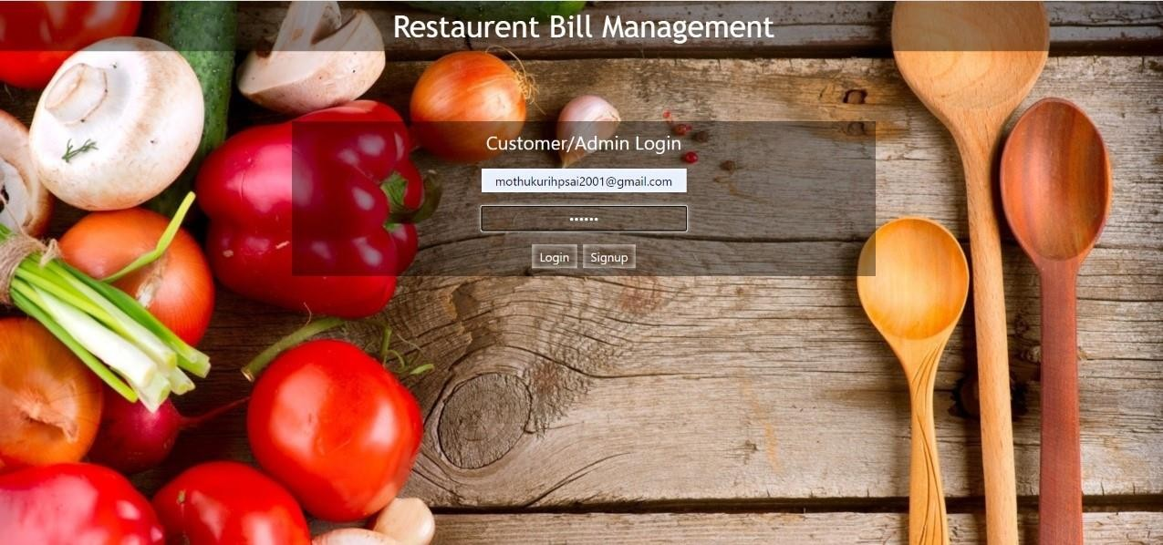
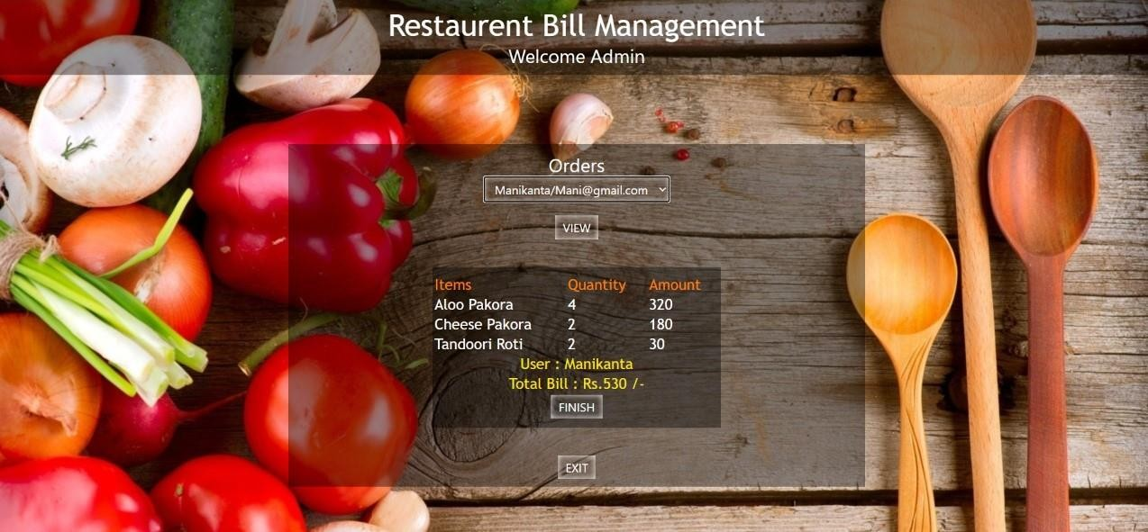
Admin Login
In order to get access to the users cart the management should create the default admin email address and password. After login in into the admin account the management can verify the users food items and generate the bill. The generated bill contains the quantity of the food order, the total price of the food items according to the quantity order along with the name of the user

Slide 6
Existing features
Before User Login:-
Sign-up
Register
Login
After User Login:-
Menu
Search food items
Add or remove food items
My cart
Order food
Logout

Slide 7
Existing features
Admin Login:-
Edit website details
Select email address of the user
Edit cart
Generate bill
Exit

Slide 8
System Analysis
The objective of the system analysis activity is to develop structured system specification for the proposed system. The structured system specification should describe what the proposed system would do independent of the technology, which will be used to implement these requirements.
The essential model may itself consist of multiple models, modeling different aspect of the system. The data flow diagrams may model the data and there relationships and the state transition diagram may model time dependent behavior of the system. The essential model thus consists of the following.
Use case diagrams
Leveled data flow diagrams
ER Diagrams
Data dictionary for the flow and stores on the DFDs

Slide 9
System Design
System design involves transformation of the user implementation model into software design. The design specification of the proposed system consists of the following:
Database scheme
Structure charts
Pseudo codes for the modules in structure charts

Slide 10
Conclusion
Hence this is the process in which the system works and it is achieved through an easy to use graphical interface menu options. The users can add any number of items to the cart from any of the available food categories by simply clicking the Add to Cart button for each item. Once item is added to the cart, user is presented with detailed order to review or continue shopping and after this they can order and enjoy their food.

Slide 11
Future Works
Providing information about the website like contact details, address of the restaurant.
Offers will also be updated regularly in the website.
Implementation of online payment mode.
Online delivery facility will also be available.
Feedback will also be added which will help to improve the restaurant.

Slide 12
THANK YOU

